Slide 1
Today’s Class
R&R – review and reinforcement ☺ – from last time
Earth’s Radiation Balance: Incoming solar radiation and albedo – how they compare to thermal emission/absorption
Notes:
Goal 2 is essentially done in the pre-class assignment.
I ended up putting most of the draft Worksheet for this day into the pre-class assignment, but depending on how they do, we might need some followup clicker questions.

Slide 2
R&R:
Power, Energy flux, black bodies and gray bodies
Vente
Grande
Tall
Short
Assume the initial temperature of the coffee, T, is the same in each cup
Notes:
Turn to neighbor and do on doc cam
Do a units clicker on the fly if needed? Options W (J/s), J, Js, W m-2

Slide 3
R&R: Power
Which of the following is true about the initial power (heat) output from each of the cups of coffee?
Vente
Grande
P_{S} > P_{T} > P_{G} > P_{V}
P_{V} > P_{G} > P_{T} > P_{S}
P_{V} = P_{G} = P_{T} = P_{S}
Tall
Short
Assume the initial temperature of the coffee, T, is the same in each cup
Notes:
Turn to neighbor and do on doc cam
Do a units clicker on the fly if needed? Options W (J/s), J, Js, W m-2

Slide 4
R&R: Power
What are the units of power?
J
Js
J s⁻¹
J s⁻¹ m⁻²
W m⁻²
Vente
Grande
Tall
Short

Slide 5
R&R: Energy Flux
Which of the following is true about the energy flux from each of the cups of coffee?
(hint: remember the units of energy flux)
Vente
Grande
Tall
E_{S} > E_{T} > E_{G} > E_{V}
E_{V} > E_{G} > E_{T} > E_{S}
E_{V} = E_{G} = E_{T} = E_{S}
Short
Notes:
Sigma*T^4*area/area – doc cam

Slide 6
Day 3 worksheet, #1
T_{R} = 280 K
T_{L} = 280 K
Is there a net transfer of energy from
Right to Left
Left to Right
Not at all
Notes:
No b/c this would violate second law thermodynamics

Slide 7
Day 3 worksheet, #2
T_{R} = 280 K
T_{L} = 280 K
Which wall changes its temperature with time?
Right
Left
Neither
Both
Notes:
neither

Slide 8
Day 3 worksheet, #3
T_{R} = 280 K
T_{L} = 280 K
Which wall will emit the most radiative flux?
Right
Left
ε = 1.0
ε = 0.6
Notes:
Discussion – get feedback and write formula on O/H projector to show it must be the right wall – give them the #s.
I=eta*sigma*T^4
I_right=349 W/m^2; I_left=209 W/m^2 but right wall absorbs all incident radiation while the left wall only absorbs 60%.

Slide 9
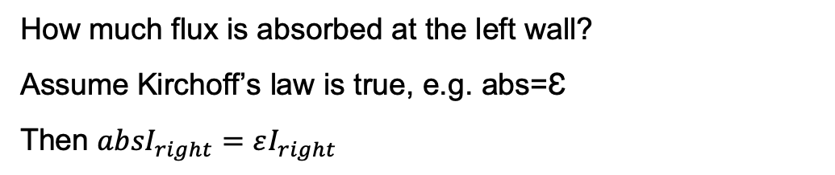
Day 3 worksheet, #4
T_{R} = 280 K
T_{L} = 280 K
I_{emit_R}
ε = 1.0
ε = 0.6
How much flux is absorbed at the left wall?
Assume Kirchoff’s law is true, e.g. abs=Ɛ
Then ${absI}_{right}=εI_{right}$
Notes:
Discussion – get feedback and write formula on O/H projector to show it must be the right wall – give them the #s.
I=eta*sigma*T^4
I_right=349 W/m^2; I_left=209 W/m^2 but right wall absorbs all incident radiation while the left wall only absorbs 60%.

Slide 10
Day 3 worksheet, #5
T_{R} = 280 K
T_{L} = 280 K
I_{emit_L}
I_{emit_R}
I_{emit_R}
I_{refl_L}
ε = 1.0
ε = 0.6
At the LH wall I_{emit_R} > I_{emit_L} so some flux must be reflected, or temperature of
LH wall would change, in violation of the 2nd law of thermodynamics
So 2nd law requires: I_{refl-L} + I_{emit-L} = I_{emit_R}

Slide 11
Notes about emissivity:
Just because a body in equilibrium emits the same amount of flux as it absorbs does not mean that the outgoing radiation will be at the same wavelength (e.g. the ocean absorbs shortwave radiation and emits longwave radiation).
Different surfaces/layers have different colors because their reflectivity changes with wavelength. For the same reason, their emissivites and absorptivities also change with wavelength.

Slide 12
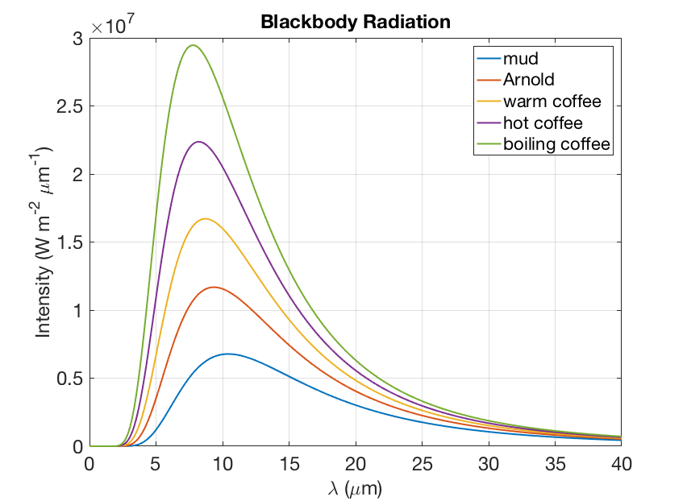
Grey body radiation
‘Grey body’ is an approximation for a real body whose emission is different from a black body in a way that depends on wavelength.
We approximate this by a constant factor, the broadband emissivity, ε, that is the ratio of the area under the true grey body curve c.f. area under the black body curve. → Grey body energy flux = εσT⁴
actual body

Slide 13
R&R: Black body spectrum
BTW: this figure shows that the actual spectrum (black) of the Sun really looks like that of a black body (green curve) with a temperature T ~ 5800 K
Notes:
BB curve using wavelength NOT wavenumber
Point is that the area under this curve is the energy flux which is independent of the area of the hot or cold item and depends only on T. Area under curve = sigma T^4m – last time Stefan Boltzmann eqn

Slide 14
Black body spectrum
What corresponds to the area under this curve?
Power
Energy flux
Neither of the above
idk
BTW: this figure shows that the actual spectrum (black) of the Sun really looks like that of a black body (green curve) with a temperature T ~ 5800 K
Notes:
BB curve using wavelength NOT wavenumber
Point is that the area under this curve is the energy flux which is independent of the area of the hot or cold item and depends only on T. Area under curve = sigma T^4m – last time Stefan Boltzmann eqn

Slide 15
BB with different T
As T increases
Peak of BB spectrum moves to shorter wavelength (or bigger wavenumber – see last time). Remember from the text book, the peak is at a wavelength of 2897/T (T in Kelvin) in μm. Check these peaks for yourself – my T = 5°C for mud, 37°C for Arnold and 80°C for hot coffee.
Curve has higher intensity at all wavelengths, so area under curve increases – we know it must b/c area under curve is equal to σT⁴
Notes:
BB curve using wavelength NOT wavenumber
Concepts: Wien’s law – peak shifts to longer(shorter) wavelength for colder(hotter) temps and total energy flux changes according to sigma*T^4
Peak wavelength of emissions in microns for coffee at 30C, 60C, 80C, 100C
9.5611 8.6997 8.2068 7.7668
Mud and Arnold 10.4209 9.3452

Slide 16
Greybodies: An approximation
Most real objects do NOT emit equally well at all wavenumbers (although water comes close in the longwave).
Instead, real objects radiate a fraction of the EM energy an ideal black body at the same temperature would radiate
We call this the “greybody” approximation:
I = εσT⁴
This is the RATIO of the actual energy emitted I to that which a blackbody would emit

Slide 17
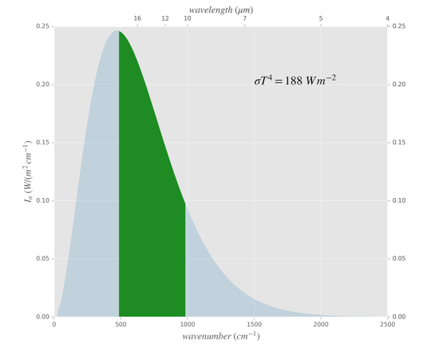
Greybodies: An approximation
Total blackbody flux (area):
This object only emits in the green wavenumber band. Green Area is 95 W/m²
The greybody emissivity is:
ε = 95/188 = 0.5
T=240 K

Slide 18
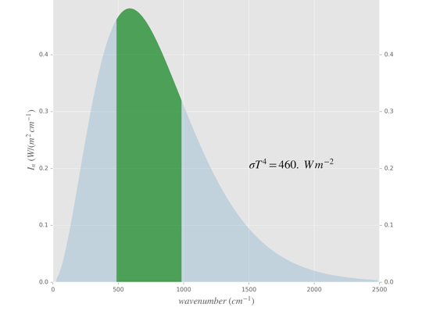
Emissivity is NOT a function of temperature
Total blackbody flux (area):
σT⁴ = 460 W/m²
This object only emits in the green wavenumber band. Green Area is 227 W/m²
The greybody emissivity is:
ε = 227/460 = 0.5
T=300 K

Slide 19
Grey body radiation
actual body
The emissivity of a gray body must be less than 1.
True
False
Notes:
Discuss what the emissivity is physically from this picture.

Slide 20
Black vs. grey bodies
What is the point of the greybody approximation? We get to ignore the details of the complex absorption/emission bands, and approximate their effect by a single number, the greybody emissivity ε. In climate models the radiation calculations typically use about 20-30 bands spanning the long and short wavelengths.
Notes:
So:
Does a BB radiate at all wavelengths – YES
Does a BB radiate equally at all wavelengths – NO
Does a BB radiate equally well at all wavelengths - YES

Slide 21
The world in the infrared
IR vs. visible video
Crucial point – at 2:30 he puts a sheet of paper (cold) over his face (hot) – note that the paper absorbs the IR flux from his face and emits much less – it is absorbing radiation and heating up. This is the definition of the greenhouse effect.

Slide 22
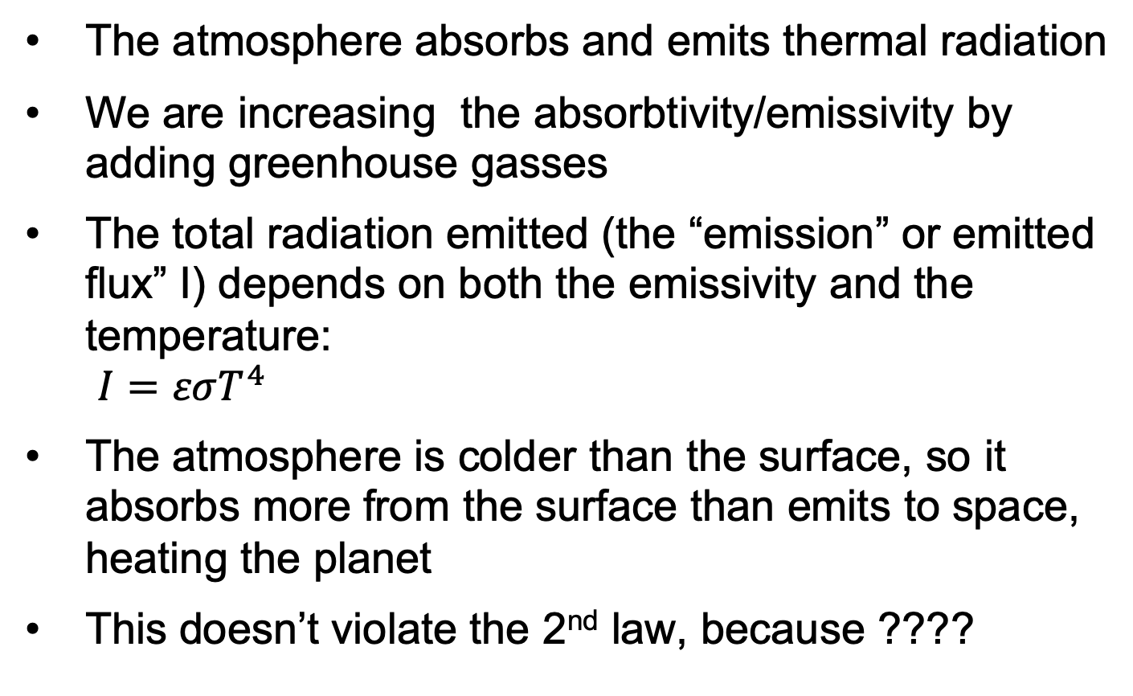
The story so far:
The atmosphere absorbs and emits thermal radiation
We are increasing the absorbtivity/emissivity by adding greenhouse gasses
The total radiation emitted (the “emission” or emitted flux” I) depends on both the emissivity and the temperature: $I=εσT^{4}$
The atmosphere is colder than the surface, so it absorbs more from the surface than emits to space, heating the planet
This doesn’t violate the 2nd law, because ????

Slide 23
Day 4: Earth’s Radiation Balance
Incoming solar radiation and albedo
Goals:
Apply systems dynamics concepts of stock and flow to Earth’s energy budget. dE/dt = I_{down} + I_{up} = I_{down} - |I_{up}|
Figure out the incoming solar radiation for Earth and other planets
Compare reflectivity of different parts of the Earth system, both on the surface and in the atmosphere.
Predict the impacts of altering solar energy or reflectivity on flows of energy in Earth's climate system, and therefore Earth's temperature (left side of Earth's energy budget diagram)
Classify particular changes in incoming solar radiation and albedo as forcings or feedbacks.
Calculate planetary temperature response to an instantaneous forcing due to the Planck feedback alone.
Notes:
Goal 2 is essentially done in the pre-class assignment.
I ended up putting most of the draft Worksheet for this day into the pre-class assignment, but depending on how they do, we might need some followup clicker questions.

Slide 24
Earth’s Climate - A Stock & Flow analogy
The “Bathtub” Balance
Iin [m³/s]
h [m]
V [m³]
Iout [m³/s]
The stock (volume of water) in the bathtub changes according to:
dV/dt = Iin - Iout
where the outflow depends on the current stock:
Iout = (const) x h
*notice the feedback mechanism*
Notes:
I thought an analogy would help...to highlight that the energy budget IS a stock & flow problem
Mention that there is a similar problem in the Assignment, but WITHOUT feedback mechanism

Slide 25

Earth’s Climate - A Stock & Flow analogy
The Earth’s Energy Balance
The “Bathtub” Balance
Idn [W/m²]
Iup [W/m²]
Iin [m³/s]
h [m]
V [m³]
Iout [m³/s]
The stock (volume of water) in the bathtub changes according to:
dV/dt = Iin - Iout
where the outflow depends on the current stock:
Iout = (const) x h
The Earth’s energy budget behaves according to:
dE/dt = Idn + Iup
where the radiation out depends on the current stock (Stefan-Boltzmann):
Iup = -εσT⁴

Slide 26
How much energy does the Earth receive from the Sun???
Let’s calculate the solar constant (use pen & paper)
Need following information
Sun outputs 3.8 x 10²⁶ W (1W = 1J/s)
Mean sun-earth distance is 150 x 10⁹ m
Area of the distance-sphere is 2.8 x 10²³ m²
Energy received at the Earth is known as the “solar constant” and is S = 1,360 W/m²
How much energy does the Earth absorb? Need radius of the earth R = 6.4 x 10⁶ m
Notes:
Basketball Ball & Light demo (dim lights):
As I move the earth farther away from the sun it becomes [brighter/dimmer]?
Subtle question - why? [Distributing the same amount of energy over larger surface area]
How much does the Earth absorb - prop: Disc with same size as ball
Then average that energy over the surface of the Earth - spin the ball
Run through the calculation on pen & paper (using doc-cam).

Slide 27

Solar constant is 1360 W/m²
At the top of the atmosphere directly facing the Sun, Earth receives 1360 W/m²
The Earth “blocks” an area in space equal to the area of a circle with Earth’s radius (πR²)
Each square meter of that imaginary circle gets 1360 W
Total energy received proportional to area of that circle
The TOTAL energy Earth captures is 1360 x πR² [W]
Distribute total energy received over the surface area of the Earth: (1360 x πR²) / 4πR² = 1360 / 4 = 340 [W/m²].
Aside: Trenberth was working with about 1365 W/m2 for the solar constant → 341 W/m²
Image credit: NASA
Notes:
Do this with pen and paper instead - include in post-class slides.

Slide 28
CLICKER: Earth’s radiation balance
If the distance between the Earth and the Sun doubles
AND
the radius of the Earth shrinks to half its current value,
how will the amount of radiation per unit area (W/m²) received at the surface of the Earth change?
A. Decreases by a factor of 2
B. Decreases by a factor of 4
C. Decreases by a factor of 8
D. Decreases by a factor of 16
Notes:
Ask students to first do question alone. Then, next, ask them to discuss it in groups, and answer again.
It’s a little tricky:
Io = P_{sun} / (4 pi R^2) x (pi r^2) / (4pi r^2) = P_{sun} / (16 pi R^2)
Because the r^2 drops out, the radius of the Earth doesn’t matter. So the decrease is a factor of 2^2=4.
R = distance earth-sun
r = radius of earth
Io = radiation density received at earth
P_{sun} = power emitted by sun

Slide 29
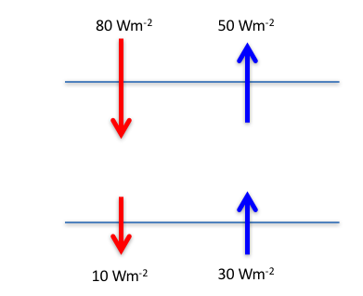
CLICKER: Heating rates? At what rate does this atmosphere (the area between the lines) heat up (+) or cool down (-)?
-
-10 Wm⁻²
-20 Wm⁻²
+20 Wm⁻²
+50 Wm⁻²
+70 Wm⁻²
-
Notes:
Answer: 50 W/m2
Can show in two ways and let them decide what they like:
Top of layer – bottom of layer, where the sign convention is followed at each boundary (i.e. up=negative and down arrows positive)
Net absorption – net emission (e.g. 110 in – 60 out) or net 70 is absorbed among red arrows and net 20 is emitted by blue arrows

Slide 30
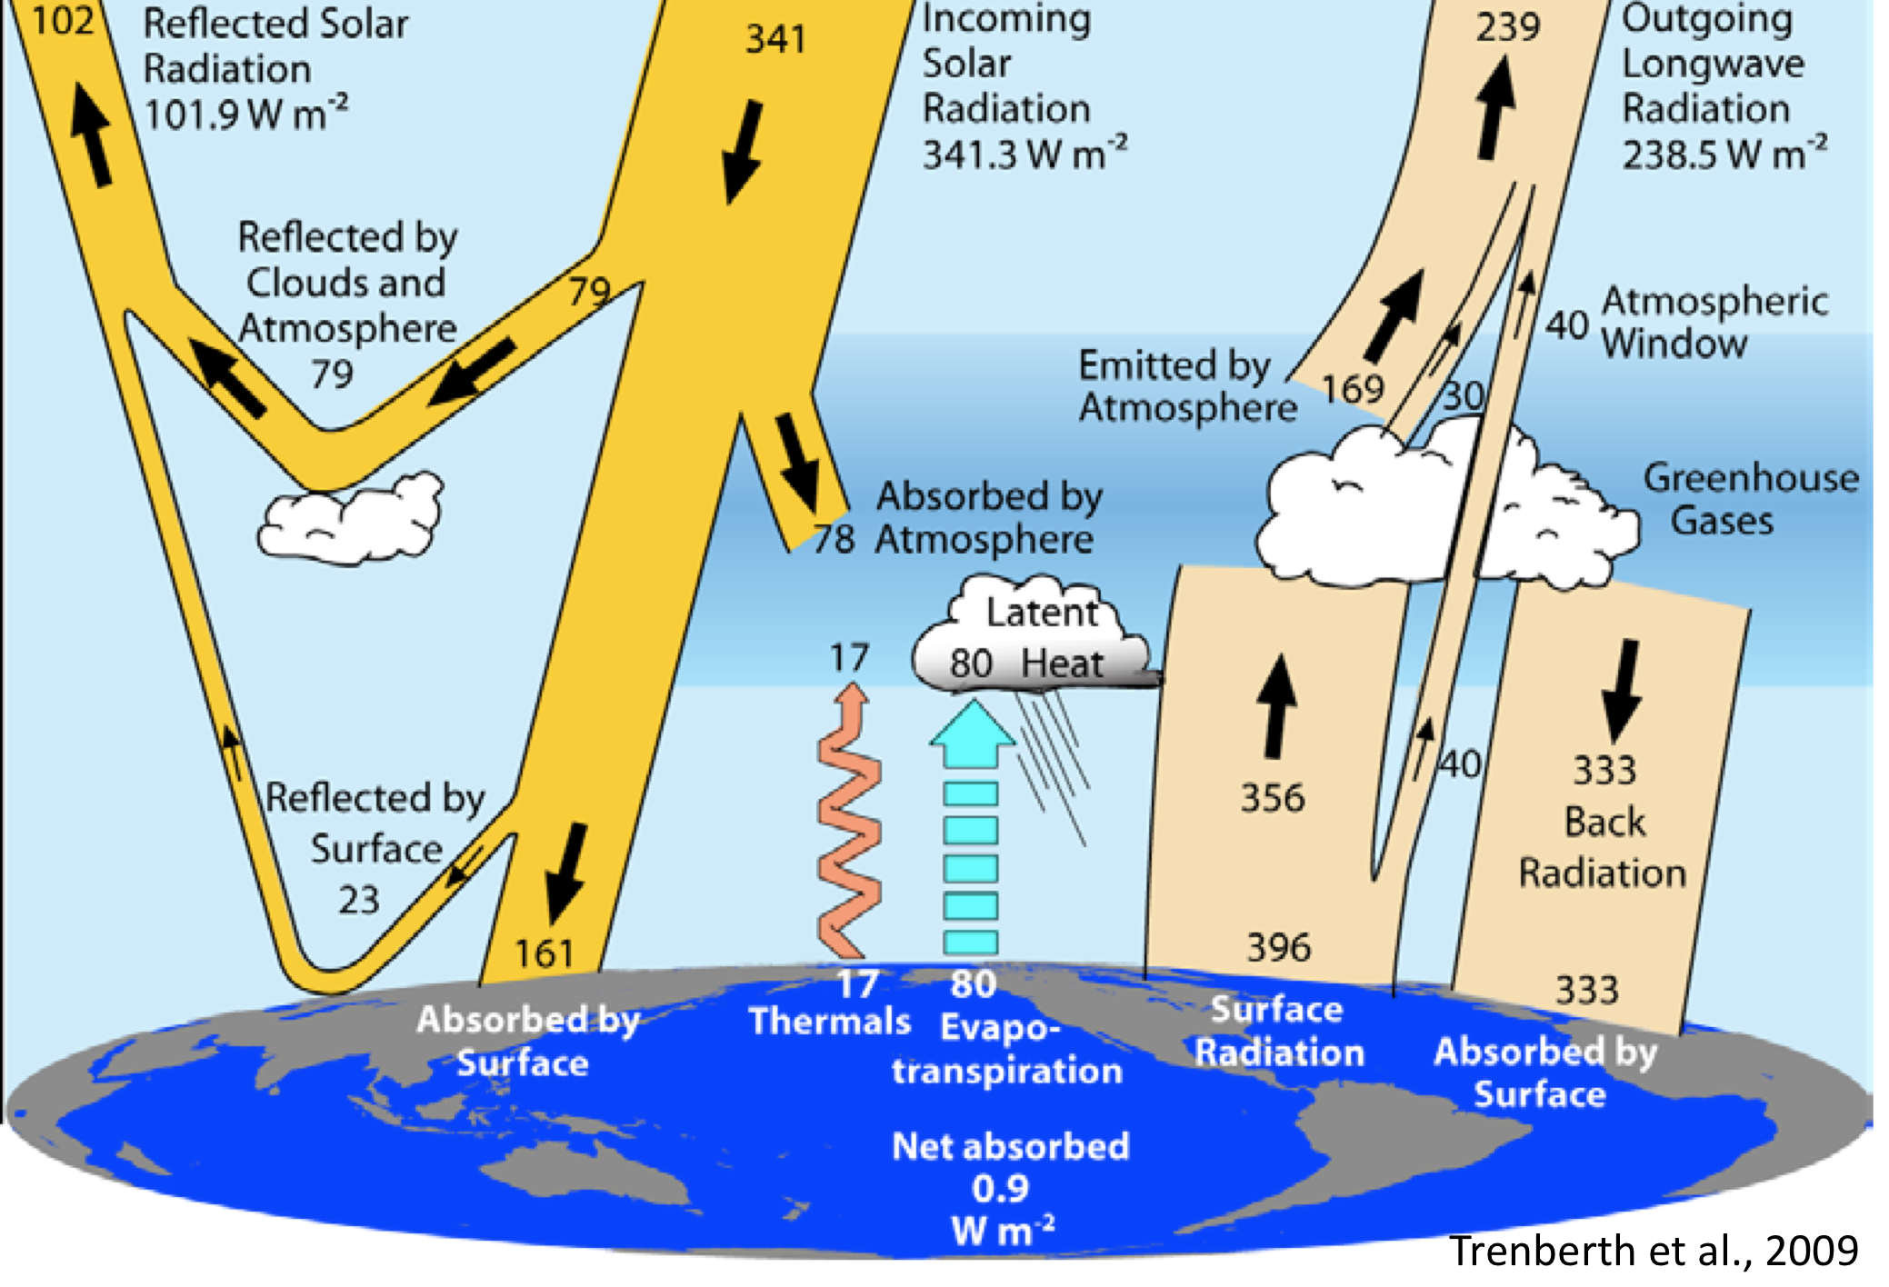
Worksheet: The Earth as a Stock and Flow Problem
238
1
168
184
2
3
*modified*
Notes:
Spring 2019: Ended here after spending a good amount of time on doc cam reviewing equations and basis for answers to slides and Day 4 quiz questions.
*Point out where I modified the rounding, so that the bigger numbers can be used for the budget calculations
LG: Apply systems dynamics concepts of stock and flow to Earth’s energy budget. dE/dt = I_{in} – I_{out}
Introduce worksheet. Point out the 341 W/m2 solar energy coming in. Solar constant/4. Newer iteration of this diagram has this number as 340 W/m2 – our course number! Easy to remember. On this diagram are FLOWS only. No stocks.
Worksheet – find all balances. Find all small imbalances that you’d expect to balance.
After students do worksheet, lead discussion of possibilities. Have multiple copies of this diagram and use the doc cam. Remember to bring different colored pens.
THIS WENT PRETTY WELL: I think we spent about 15 minutes with them working, 5 minutes wrapup.
Trenberth, K. E., Fasullo, J. T., & Kiehl, J. (2009). Earth’s Global Energy Budget. Bulletin of the American Meteorological Society, 90(3), 311–323. doi:10.1175/2008BAMS2634.1

Slide 31
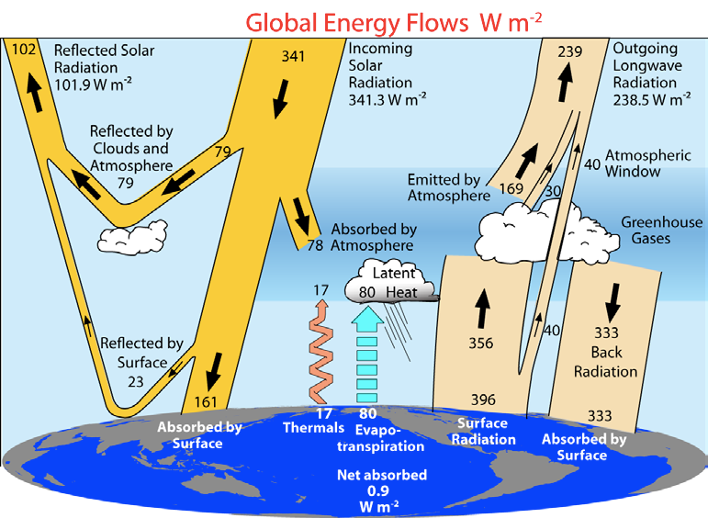
Focus on Albedo – left side of diagram
Trenberth et al., 2009
Notes:
LG: Compare reflectivity of different parts of the Earth system, both on the surface and in the atmosphere.
ASK: Which is more important when talking about reflectivity (albedo) of the Earth: the Earth’s surface or the Earth atmosphere?
We’re going to focus on albedo for a while here. According to Trenberth, about 23 W/m2 are reflected off the surface directly back to space, and about 79 w/m2 are reflected off stuff in the atmosphere and goes directly back to space.

Slide 32
Summary
Balances of flows of energy in, out, and within Earth’s climate system determine Earth’s temperature.
We use the “grey body approximation” to estimate the emissivity/absorptivity of the atmosphere
Kirchoff’s law guarantees that ε=abs because otherwise we violate the 2nd law of thermodynamics
Solids, liquids and gasses emit radiation according to their temperature and their emissivity via the Stefan-Boltzman equation: I = εσT⁴
These same objects absorb radiation with constant abs=ε that is independent of temperature.
That means that cold air can absorb radiation from a warm surface, but not re-radiate all that it has absorbed This is heating because of the imbalance is called the “greenhouse effect”
This doesn’t violate the 2nd law because this system is not isolated – the surface is warmer that the atmosphere because it is absorbing sunlight that passes straight through air.
Notes:
Apply systems dynamics concepts of stock and flow to Earth’s energy budget. dE/dt = I_{in} – I_{out}
Figure out the incoming solar radiation for Earth and other planets
Compare reflectivity of different parts of the Earth system, both on the surface and in the atmosphere.
Predict the impacts of altering solar energy or reflectivity on flows of energy in Earth's climate system, and therefore Earth's temperature (left side of Earth's energy budget diagram)
Classify particular changes in incoming solar radiation and albedo as forcings or feedbacks.
Calculate planetary temperature response to an instantaneous forcing due to the Planck feedback alone.

Slide 33
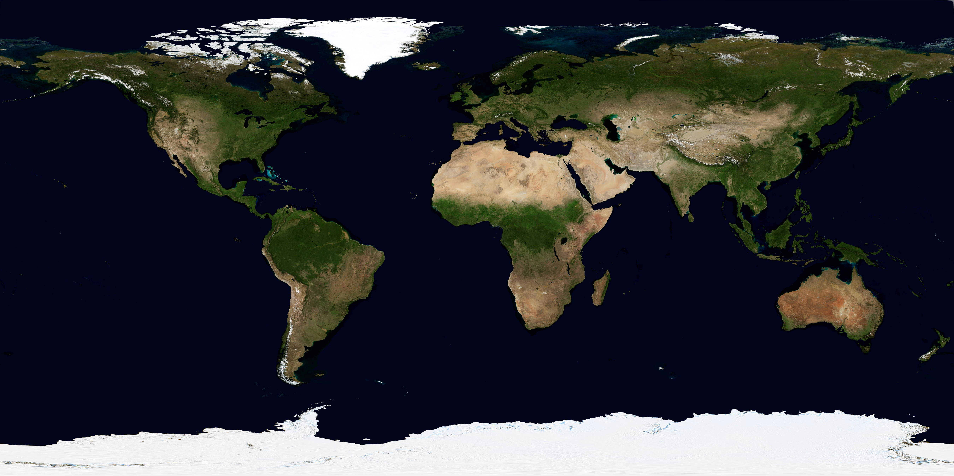
“If we were to approximate the average albedo of each of the hemispheres of the Earth, would we get significantly similar quantities?”
Earth’s surface if the planet were cloud-free
image: NASA
Which parts of the Earth are MORE reflective?
Which parts of the Earth are LESS reflective?
What is the single largest reason that the Earth’s albedo is relatively LOW?
Notes:
LG: Compare reflectivity of different parts of the Earth system, both on the surface and in the atmosphere.
What’s the stuff that’s pretty reflective? Deserts and ice.
What’s the stuff that’s not very reflective? Oceans and forests. What does that mean about absorption by oceans and forests? MORE absorption.

Slide 34
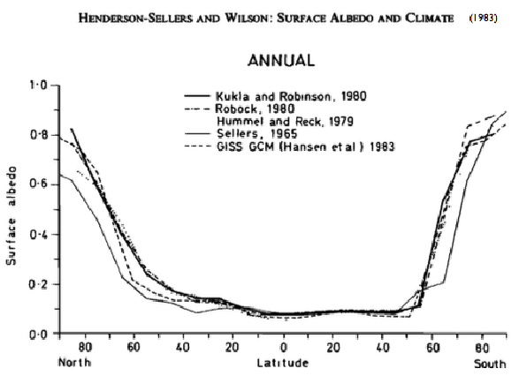
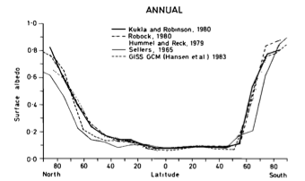
Notes:
Average annual albedo –CLJ I replaced Sara’s slide b/c it was very blurry. It did have refs on it though.

Slide 35
CLICKER: What if the forest expanded into the desert area (and nothing else changed)?
Reflectivity would _______.
A. Increase B. Decrease C. Stay the same
NASA
NASA
Notes:
LG: Compare reflectivity of different parts of the Earth system, both on the surface and in the atmosphere.
ANSWER: B

Slide 36
CLICKER: What if sea level rose (and nothing else changed)? Reflectivity would _______.
A. Increase B. Decrease C. Stay the same
NASA
NASA
Notes:
LG: Compare reflectivity of different parts of the Earth system, both on the surface and in the atmosphere.
ANSWER: B
But a lot of students chose C and explained that they chose that because of the wording “nothing else changed”, so they assumed that sea level rose straight up and no flooding happened. Rewording needed. Fall 2013 – I said I would take both B and C.

Slide 37
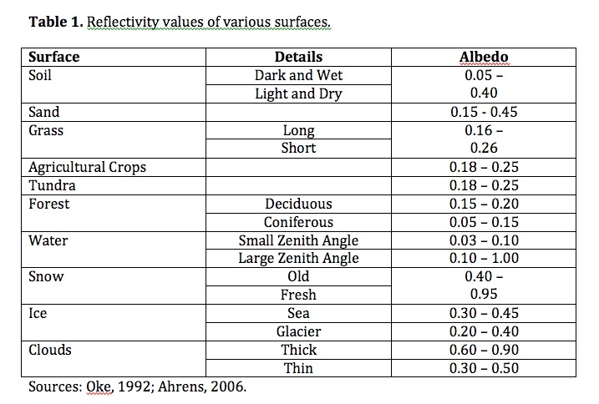
Some Surface Albedos
Compare these
From http://www.eoearth.org/view/article/149954/
NASA
Notes:
LG: Compare reflectivity of different parts of the Earth system, both on the surface and in the atmosphere.
You’ll see other numbers too, but the comparative relationships are consistent.

Slide 38
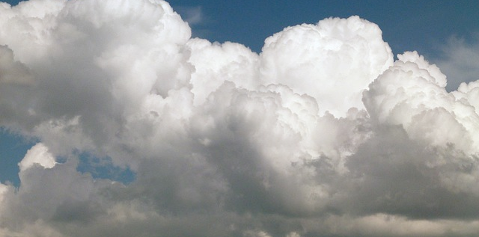
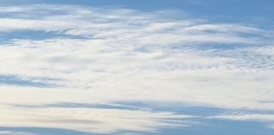
Cloud Albedo is Variable
THICK: more reflective (0.5-0.7)
THIN: less reflective (0.1-0.5)
Cloud reflectivity is one of the big unknowns that make predictions about future climate uncertain. Will future cloud albedos be bigger or smaller?
The reflectivity of clouds is determined by water droplet density AND droplet size. Drop-for-drop, smaller drops have larger surface area to volume ratio. More SA = greater reflectivity.
NASA
Notes:
LG: Compare reflectivity of different parts of the Earth system, both on the surface and in the atmosphere.
You’ll see other numbers too, but the comparative relationships are consistent.
Have to make the point that small droplets and higher concentration are NOT nec associated with thick clouds, it’s just that these characteristics make clouds more/less reflective.

Slide 39
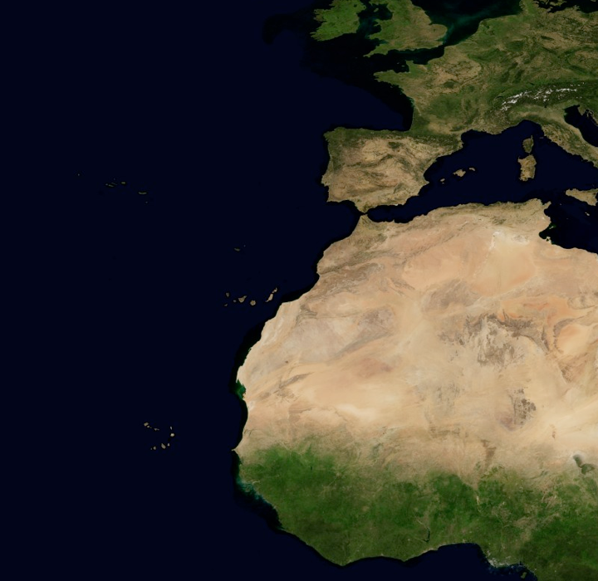
Aerosol Albedo -
MORE reflective: Sea salt particles, Sulfate aerosols, Mineral dust
LESS reflective: Black carbon (ie. “soot”)
NASA
Notes:
LG: Compare reflectivity of different parts of the Earth system, both on the surface and in the atmosphere.
Here we’re basically interested in reflection of shortwave, incoming radiation. Reflection and scattering DO vary as a function of wavelength though.
Note: This can be brief

Slide 40
CLICKER: What if sunspots change incoming solar radiation?
A. Forcing B. Feedback C. Could be either
Trenberth et al., 2009
Notes:
LG: Classify particular changes in incoming solar radiation and albedo as forcings or feedbacks.
ANSWER: A. Forcing

Slide 41
CLICKER: What if ice on Earth’s surface melts?
A. Forcing B. Feedback C. Could be either
Trenberth et al., 2009
Notes:
LG: Classify particular changes in incoming solar radiation and albedo as forcings or feedbacks.
ANSWER: B. Feedback

Slide 42
CLICKER: What if coal-burning increases sulfate aerosols?
A. Forcing B. Feedback C. Could be either
Trenberth et al., 2009
Notes:
LG: Classify particular changes in incoming solar radiation and albedo as forcings or feedbacks.
ANSWER: A. Forcing
David offered a way this could be a feedback (no students did though).
CLJ – presumably the feedback is temperature decreases → more coal burned to keep warm → sulfate aerosol increases → reflectivity increases → more cooling

Slide 43
IDENTIFY: “Amplifying” or “Stabilizing”
Necessary to distinguish between two types of feedback mechanisms:
The initial change (perturbation) is continually amplified by the feedback mechanism → AMPLIFYING (positive)
The initial perturbation is dampened by the feedback mechanism → STABILIZING (negative)
We will revisit this on Day 11 - For now, let’s do some practice
Notes:
LG: Classify particular changes in incoming solar radiation and albedo as forcings or feedbacks.
Trenberth, K. E., Fasullo, J. T., & Kiehl, J. (2009). Earth’s Global Energy Budget. Bulletin of the American Meteorological Society, 90(3), 311–323. doi:10.1175/2008BAMS2634.1
Try to create some microphone feedback? – did not do this.
On the first day index cards (Fall 2012), students mainly said things like:
Forcings are the cause, feedbacks are the effect (THIS IS THE BIG CATEGORY)
Forcings are caused by humans, feedbacks are natural (or vice versa)
Forcings are direct, feedbacks are indirect
Forcings are direct, feedbacks are cyclic

Slide 44
CLICKER: Clouds are involved in several different feedbacks. Is this one amplifying or stabilizing?
Warming
A. Amplifying
B. Stabilizing
C. Could be either
Perturbation
More water in a warmer atmosphere
?
?
Greater cloud low cover
Greater reflectivity
Notes:
LG: Predict the impacts of altering solar energy or reflectivity on flows of energy in Earth's climate system, and therefore Earth's temperature (left side of Earth's energy budget diagram)
THIS SEEMS NOT QUITE DIRECTLY RELATED. MAYBE FOLLOWUP WITH DISCUSSION OF HOW T WOULD CHANGE?
ANSWER: B. Stabilizing.

Slide 45
Warming
Stabilizing!
Perturbation
More water in a warmer atmosphere
Cooler temperatures counteract warming
Greater cloud cover
Greater reflectivity
Notes:
LG: Predict the impacts of altering solar energy or reflectivity on flows of energy in Earth's climate system, and therefore Earth's temperature (left side of Earth's energy budget diagram
DON’T LABEL IT – stabilizing.

Slide 46
CLICKER: The Planck Feedback. Amplifying or Stabilizing?
Increase energy inflow
A. Amplifying
B. Stabilizing
C. Could be either
Perturbation
Imbalance of inflow and outflow of energy
???
dE/dt = I_{up} + I_{dn}
???
Earth’s temperature ???
Iup = -εσ T⁴
Radiation
emitted ???
Notes:
LG: Calculate planetary temperature response to an instantaneous forcing due to the Planck feedback alone.
ANSWER: B stabilizing

Slide 47
CLICKER: The Planck Feedback. Amplifying or Stabilizing?
Decrease energy inflow
A. Amplifying
B. Stabilizing
C. Could be either
Perturbation
Imbalance of inflow and outflow of energy
???
dE/dt = I_{up} + I_{down}
???
Earth’s temperature ???
Iup = -εσ T⁴
Radiation
emitted ???
Notes:
LG: Calculate planetary temperature response to an instantaneous forcing due to the Planck feedback alone.
ANSWER: B stabilizing

Slide 48
The Planck Feedback: Amplifying or Stabilizing?
Decrease energy inflow
Increase energy inflow
Perturbation
Perturbation
Imbalance of inflow and outflow of energy
Imbalance of inflow and outflow of energy
…until outflow and inflow match
Earth’s temperature decreases
…until outflow and inflow match
Earth’s temperature increases
Emission decreases…
Emission increases…
Notes:
LG: Calculate planetary temperature response to an instantaneous forcing due to the Planck feedback alone.
ANSWER slide

Slide 49
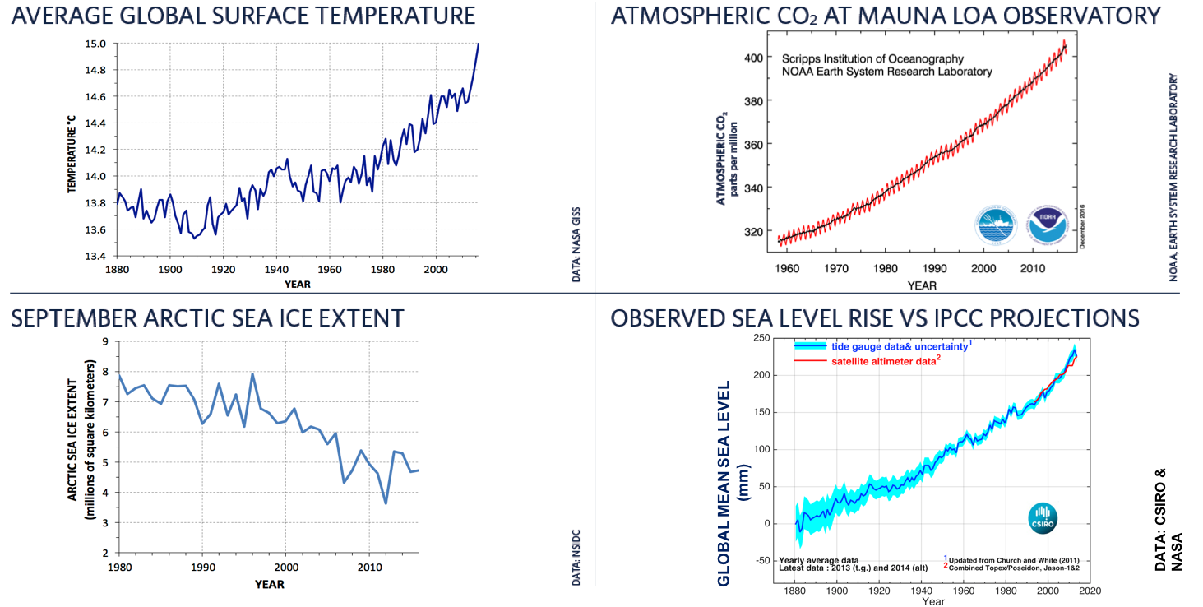
Temperature and sea ice trends due to both forcings (CO₂, aerosols) and weather (wind patterns)
aerosol cooling
wind transport through Fram strait

Slide 50
unused

Slide 51
Day 4 PreClass Quiz Feedback
I am confused about question 3. Why do we need to average over the total surface area of the Earth to do this question?? The numbers given are already the averages.
How is the radius from the sun a determining factor in the solar constant?
Can you go over the calculations in more detail during class? We can do that
Why is it ok to assume that the earth's albedo is 0.3, when the surface areas of the different parts of Earth are so different (i.e. ALL desert, ALL snow, some land, some snow etc...)? Averaging - it’s a model
If we were to approximate the average albedo of each of the hemispheres of the Earth, would we get significantly similar quantities? Let’s come back to this
As well, why are power and energy used interchangeably in climate calculations? Which symbols do I use? Context matters - be flexible - check units
Question 4 was difficult, I had difficulty understanding what the question was asking and how to approach it. Do it at the end of class, IF we have time
How was Stefan Boltzmann inspired to study this?
Josef Stefan and Ludwig Boltzman

Slide 52
The Planck Feedback (I)
FIRST: No sun → Earth emits 0.06 W/m² (geothermal source)
Recall: σ = 5.67 x 10⁻⁸ W/m²/K. Assume ε = 1. No atmosphere.
CLICKER: What is Earth’s temperature?
A. About 6 K
B. About 32 K
C. About 112 K
D. About 273K
Notes:
LG: Calculate planetary temperature response to an instantaneous forcing due to the Planck feedback alone.
Also getting at…
LG: Predict the impacts of altering solar energy or reflectivity on flows of energy in Earth's climate system, and therefore Earth's temperature (left side of Earth's energy budget diagram)
ANSWER: B

Slide 53
NEXT: Turn on Sun
Suddenly, Earth receives 341 W/m².
Albedo = 0.3
No atmosphere
Assume ε = 1
σ = 5.67 x 10⁻⁸ W/m²/K
341 W/m²
Reflected
{??}
?
Absorbed
{??}
Earth’s surface
CLICKER: What will happen?
Earth will immediately become 278 K
Earth will warm, over time, to 278 K
Earth will immediately become 255 K
Earth will warm, over time, to 255K
Earth will warm up, but we can’t tell how much.
Notes:
LG: Calculate planetary temperature response to an instantaneous forcing due to the Planck feedback alone.
Also getting at…
LG: Predict the impacts of altering solar energy or reflectivity on flows of energy in Earth's climate system, and therefore Earth's temperature (left side of Earth's energy budget diagram)
ANSWER: D 255K
Started off discussion asking about the difference between “immediately” versus “over time”. Which more likely?

